Slide 1
Text mining of children's essays about animals kept at schools focusing on importance of life and attachment to animals
K.Hori T.Ito T.Ando
（Seigakuin University) （Wako University) （Yokohama National University)
Oral presentation on July 26, 2016
ICP2016 Yokohama

Slide 2
Research Background Rearing Activities for School Animals in Japan
Keeping animals at schools in Japan
→An attempt that began in Meiji era. However, structural systems to incorporate such activities into school education is still insufficient.
From around 1980s,
veterinarians spontaneously began providing support in caring for school animals at their neighboring elementary schools. Ex. The Tokyo Veterinary Medical Association.→As a part of their support project, they collected and published children’s essays from model schools.
To examine the significance of animal rearing activities in school education.→These children’s essays are effective materials for analysis.

Slide 3
Significance of the Research: Analysis of Essays
Analysis of Essays： Generally focuses on sentence composition and comprehension abilities
→Evaluation criterion change according to the developmental stages. Difficult to compare.
To investigate the significance of animal rearing activities: Must examine the actual experience of children while considering their different developmental stages.
Method to examine the significance of animal rearing experience from essay analysis
=Utilization of text mining
Enables an exploratory examination on the significance of animal rearing experience, interaction with animals, development of feelings and affection, development of inter-human communication ability through animal caretaking activities, etc.

Slide 4
Research Objective
To analyze children’s essays from model elementary schools with text mining,
and conduct an exploratory investigation about
what interest the children had in animals,
what activities they were involved in,
what feelings animal caring activities generated.

Slide 5
Method
Research Object: “Essays From Model School Project for Rearing School Animals” 4 Volumes, (2001-2004), prints 386 essays by elementary school students
Research Method: Converting essay contents into text data, and conducting analysis on content words with text mining methods.
Utilized Software: Text Mining Studio Ver.4.1 (Mathematical Systems Inc.)

Slide 6
Result 1: Basic Information
Target essays: essays written by 386 students
Average character count per person: 326.3 characters
Average sentence length: 14.6 characters for one sentence
Total number of content words: 50417 words
Total number of different words: 5313

Slide 7
Result 2: Number of Essays Among Class Grades
Table1. Number of essays among class grades
Table2. Number of essays among higher and lower class grades
Grade | Number of essays
1st | 41
2nd | 95
3rd | 26
4th | 87
5th | 54
6th | 82
Unknown | １
Grade | Number of Essays
Lower Grades（1st ～3rd ） | 162
Higher Grades（4th ～6th ） | 223
Unknown | 1

Slide 8
Result 3: High appearance words and commonly used words
Table 3. High appearance words
Word | think | rabbit | present | do | say | animal | bantam | cleaning | care | cute
Word Class | verb | noun | verb | verb | verb | noun | noun | noun | noun | adjective
Appearance Frequency(Number of Words) | 1185 | 1116 | 434 | 424 | 400 | 365 | 357 | 317 | 298 | 293
Table 4. Commonly used words
Word | think | rabbit | present | do | say | cute | perform | See | good | school
Word Class | verb | noun | verb | verb | verb | adjective | verb | verb | adjective | noun
Number of users (persons) | 310 | 215 | 209 | 183 | 182 | 181 | 161 | 158 | 156 | 152

Slide 9
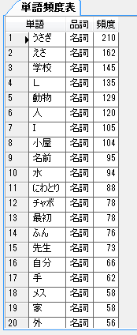
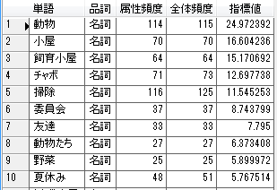
Result 4:
Nouns = Topics and themes
Word
Word Class
Frequency
Table 5. Usage frequency of Nouns
Rabbits
Food
School
L
Animal
Person
I
Shed
Name
Water
Chicken
Bantam
Beginning
Dung
Teacher
Oneself
Hands
Female
House
Outside
Noun
Noun
Noun
Noun
Noun
Noun
Noun
Noun
Noun
Noun
Noun
Noun
Noun
Noun
Noun
Noun
Noun
Noun
Noun
Noun
Frequently used general nouns among higher grades (Chi-squared test, p<.05)
Word
Word Class
Attribute Frequency | Total Frequency | Index Value
Animal
Shed
Rearing shed
Bantam
Cleaning
Committee
Friends
Animals
Vegetables
Summer vacation
Noun
Noun
Noun
Noun
Noun
Noun
Noun
Noun
Noun
Noun
Frequently used general nouns among lower grades (Chi-squared test, p<.05)
There were no distinguishable differences among words

Slide 10
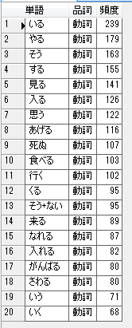
Result 5-1: Verbs = Actions
Table 6. Usage frequency of verbs
Word
Word Class
Frequency
Present
Do
In that way
Perform
See
Enter
Think
Give
Die
Eat
Go(Chinese character )
Come(Japanese character )
Not + in that way
Come(Chinese character)
Can become
Can enter
Endeavor
Touch
Say
Go(Japanese character )
Verb
Verb
Verb
Verb
Verb
Verb
Verb
Verb
Verb
Verb
Verb
Verb
Verb
Verb
Verb
Verb
Verb
Verb
Verb
Verb

Slide 11
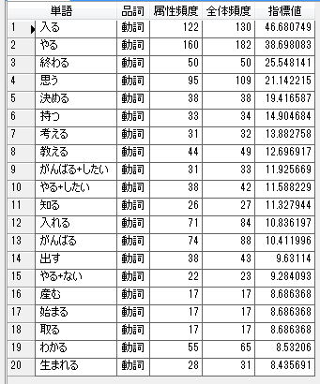
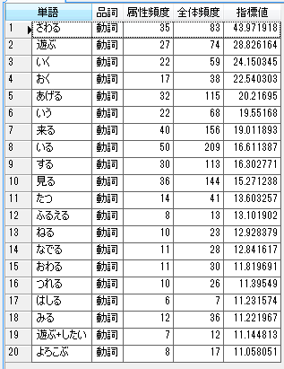
Result 5-2:Usage frequency of verbs among higher and lower grades
High group of usage frequency elicited from gap between expected value and actual value of verb usage frequency calculated from population ratio.
Table 7. Usage frequency of verbs among higher and lower grades
Frequently used verbs among higher grades (Chi-squared test, p<.05)
Frequently used verbs among lower grades (Chi-squared test, p<.05)
Enter
Do
End
Deem
Judge
Have
Think
Teach
Want + do best
Want + do
Know
Put in
Do best
Put out
No + do
Give birth
Begin
Take
Understand
Be born
Verb
Verb
Verb
Verb
Verb
Verb
Verb
Verb
Verb
Verb
Verb
Verb
Verb
Verb
Verb
Verb
Verb
Verb
Verb
Verb
Touch
Play
Go
Put
Give
Say
Come
Present
Perform
See(kanji )
Stand
Shake
Sleep
Pet
End
Catch
Run
See
Want+ play
Be pleased
Verb
Verb
Verb
Verb
Verb
Verb
Verb
Verb
Verb
Verb
Verb
Verb
Verb
Verb
Verb
Verb
Verb
Verb
Verb
Verb

Slide 12
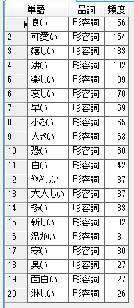
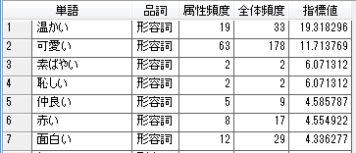
Result 6: Adjectives
= Feelings and evaluation
Word | Word Class | Frequency
Good | Adjective
Cute | Adjective
Happy | Adjective
Amazing | Adjective
Fun | Adjective
Sad | Adjective
Fast | Adjective
Small | Adjective
Big | Adjective
Scary | Adjective
White | Adjective
Kind | Adjective
Gentle | Adjective
Many | Adjective
New | Adjective
Warm | Adjective
Cold | Adjective
Stinky | Adjective
Interesting | Adjective
Lonely | Adjective
Table 8. Usage frequency of Nouns
Frequently used adjectives among higher grades (Chi-squared test, p<.05)
Word | Word Class
Hot | Adjective
Many | Adjective
Scary | Adjective
Attribute Frequency | Total Frequency | Index Value
Frequently used adjectives among lower grades (Chi-squared test, p<.05)
Word
Word Class
Attribute Frequency | Total Frequency | Index Value
Warm | Adjective
Cute | Adjective
Quick | Adjective
Shameful | Adjective
Friendly | Adjective
Red | Adjective
Interesting | Adjective

Slide 13
Discussion 1
Nouns (express topics and themes)→ Rabbits appeared frequently (from high appearance words and commonly used words).
Verbs (express actions)→ Both expressions of active expression and interest appeared. Estimated from combining analysis of usage frequency of verbs and subject-predicate relations among higher and lower grades.
(Higher grades) were characterized by active participation, like “joining the animal rearing committee,” (we) “feed” and “clean.”
(Lower grades) were characterized by expressions of interest rather than active participation, like “touch”(the animals), “play”(with the animals)” and “go” to the animal shed.

Slide 14
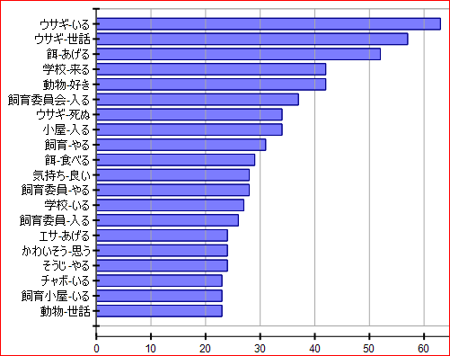
Result 7: Matching frequency of subject and predicate words
Rabbit ~ is present
Rabbit-care
Food(Chinese character)-give
School-come
Animal-like
Animal Rearing Committee-enter
Rabbit-die
Shed-enter
Care-do
Food-eat
Feel-good
Caretaker-do
School-present
Caretaker-enter
Food(Japanese character )-give
Bad-feel
Cleaning-do
Bantam-present
Animal shed-present
Animal-care
Figure 1. Matching frequency of subject and predicate words

Slide 15
Discussion 2
Adjectives (express feelings and evaluation)
→ Feelings generated by keeping animals, and feelings experienced toward the animals were commonly positive.
(Feelings generated from keeping animals ) “good,” “happy,” “fun”
(Toward animals) “cute,” “amazing”
Comparison between word count of appearance frequency and commonly used language
→ Results reflected standpoints of “active participation” and “do not participate but show interest.”
Overall, children were positive about animals and keeping animals regardless of their grades.

Slide 16
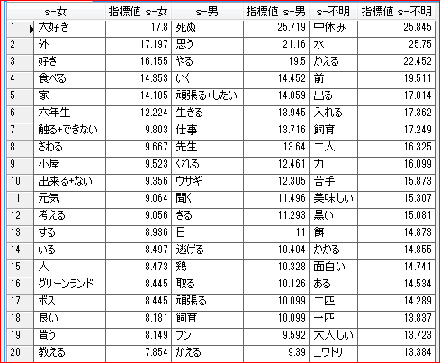
Result 8: Usage frequency of words among genders
Table 9. Usage frequency of words among genders
s-girls
Index Value
s-boys
Index Value
s-unknown
Index Value
Love
Outside
Like
Eat
House
6th grade
Touch + cannot
Touch
Shed
Can + not
Well
Think
Perform
Present
Person
Greenland
Boss
Good
Receive
Teach
Die
Deem
Do
Go
Work hard + want
Live
Task
Teacher
Give to me
Rabbit
Listen
Wear
Day
Escape
Chicken(鶏)
Take
Work hard
Rearing
Dung
Change
Recess
Water
Change
Front
Go out
Put in
Rearing
Two people
Strength
Dislike
Tasty
Black
Food
Take
Interesting
Is there
Two animals
One animal
Calm
Chicken

Slide 17
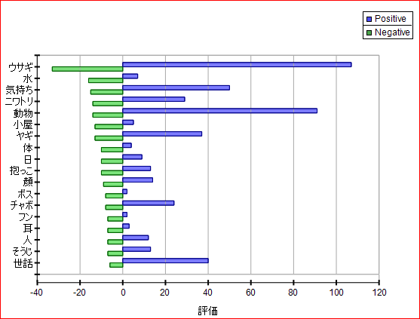
Result 9: Positive and negative common noun expressions
Rabbit
Water
Feelings
Chicken
Animals
Shed
Goat
Body
Day
Carry in arms
Face
Boss
Bantam
Dung
Ears
Person
Cleaning
Care
Evaluation
Figure 2. Positive and negative common noun expressions

Slide 18
Discussion 3
1. From usage frequency of verbs among genders:
Girls: Naturally had affectionate and nurturing point of view toward animals. Ex. “like (love)” “(animals) eat,” “touch,” “cannot touch,” “well,” “present,” “outside.”
Boys: Captured it as a task. Attained observations from continuously being around life and death. Ex. “I want to work hard,” “task,” “teacher, “die,” “live,” “escape.”
2. From the sorting results of positive and negative depictions of nouns:
(Utilization of Text Mining Studio Ver.)
Rabbit→ Depicted most in both the positive and negative context.
Other nouns→Less negative expressions. Very positive expressions for nouns like feelings, animal, goat, bantam, care, etc.

Slide 19
Conclusion and Future Tasks
This research confirmed that children in “Model School Project for Keeping School Animals for Education” experienced:
Accomplishment and being fond of taking care of animals.
Labor participation and understandings of animals.
Compassion for animals and others.
Enjoyment in interacting with animals.
Personified animals in perceiving happiness of animals.
One’s own happiness and reflexivity.
Future Tasks：
Investigate the significance of schools with animal rearing education by comparing this research result to that of children without the experience of keeping school animals.

